Slide 1
Logistic Regression
DSBA/MBAD 6211

Slide 2
Logistic Regression Overview
Logistic regression is a predictive technique used when the dependent variable has binary outcomes (e.g., outage or no outage; 1 or 0)
The logistic regression estimate calculates the probability of the event occurring based on past data
Logistic regression is considered “supervised learning technique” since the data includes actual outcome values from past observations
Examples of logistic regression applications
Predicting the probability of a system or part failing
Predicting the probability of a subscriber cancelling a service (churn)
Predicting the probability of a patient readmission
Predicting the probability of an outage

Slide 3
Multiple Linear Regression Prediction
^
^
^
^
prediction
estimate
y
= β₀ + β₁ x₁ + β₂ x₂
intercept
estimate
parameter
estimate
Choose intercept and parameter estimates to minimize:
squared error function
^
∑( y_{i} – y_{i} )²
training
data

Slide 4
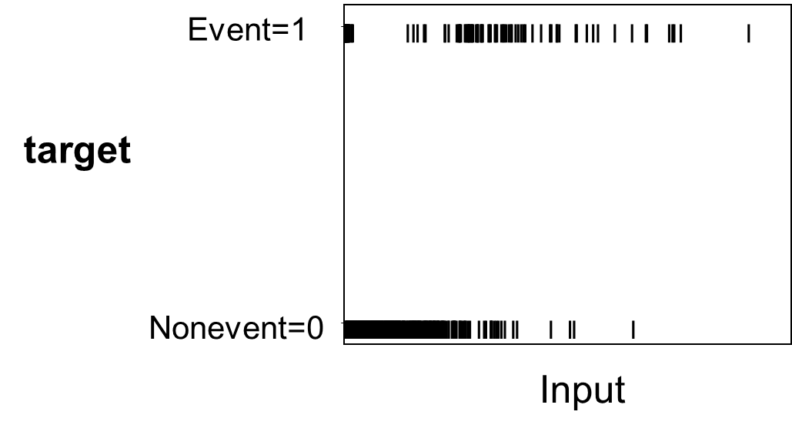
Binary Dependent Variable
When the dependent variable is binary (e.g., values 1 or 0), linear regression does not work directly, since the results are generally unbounded.
Instead, we use the probability p that the event will occur rather than directly using 1 or 0 .

Slide 5
Why Linear Regression Will Not Work?
If linear regression is used, the predicted values will become greater than one and less than zero if you move far enough on the X-axis. Such values are theoretically inadmissible.
An assumption of regression is that the variance of Y is constant across values of X (homoscedasticity). This cannot be the case with a binary variable, because the variance is p*(1-p), where p is the probability of the event. When 50 percent of the observations are 1s, then the variance is .25, its maximum value. As we move to more extreme values, the variance decreases. When p=.10, the variance is .1*.9 = .09, so as p approaches 1 or zero, the variance approaches zero.
Another assumption is that errors of prediction (Y-Y') are normally distributed. Because Y only takes the values 0 and 1, this assumption is pretty hard to justify, even approximately.

Slide 6
Odds and Probability
Consider the probability p of an event (such as an outage) occurring.
The probability of the event not occurring is 1-p.
The odds of the event happening are p:(1-p)
For example, if the probability of outage p=0.2, the odds are
Odds may also be expressed as integers such as 1:4, which means that in every 5 events, 1 event is an outage and 4 events are non-outages
From the above odds, the probability of an outage is computed as

Slide 7
Properties of Odds and Log Odds
Odds is not symmetric, varying from 0 to infinity.
Odds is 1 when the probability is 50%.
Log Odds is symmetric, going from minus infinity to positive infinity, like a line.
Log Odds is 0 when the probability is 50%.
It is highly negative for low probabilities and highly positive for high probabilities.

Slide 8
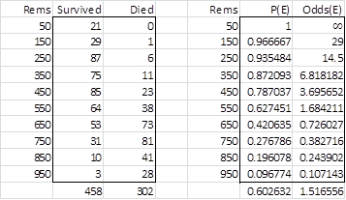
A Sample Dataset
Following a nuclear accident, individual’s radiation exposure and survival were captured in a dataset. The objective is to estimate the relationship between the radiation exposure (in Rems) and survival.
Source: http://www.real-statistics.com/logistic-regression/basic-concepts-logistic-regression/

Slide 9
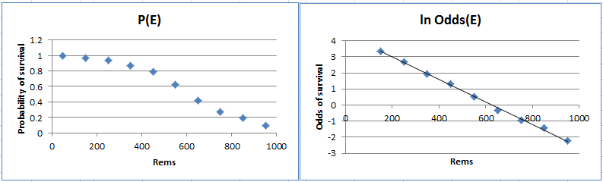
Comparing p(E) vs ln(odds(E))
E = event, which in this case is the individual survived
Source: http://www.real-statistics.com/logistic-regression/basic-concepts-logistic-regression/

Slide 10
Logistic Regression Prediction Formula
p
1 – p
(
^
)
^
^
^
ln
= β₀ + β₁ x₁ + β₂ x₂
^
logit
link function
5
The left-hand side of the above expression is called the logit link function. The logit link function transforms probabilities (between 0 and 1) to logit scores (between −∞ and +∞).
0
1
-5

Slide 11
Logistic Regression Prediction Formula
p
1 – p
(
^
)
^
^
^
^
ln
= β₀ + β₁ x₁ + β₂ x₂
logit( p )
=
^
logit scores
^
To obtain prediction estimates, the logit equation is solved for p.
1
1 + e^{-logit( p )}
^
p =
^

Slide 12
Estimation
Maximum likelihood estimation
An iterative procedure that successively works to get closer and closer to the correct fit.
A model that fits the data well will have a small absolute value of log-likelihood*. A perfect model would have a log-likelihood value of zero.
In the statsmodels Python library, Log-Likelihood (negative) value will be reported in the output. The larger this value(i.e., smaller absolute value), the better is the model. LL-Null is the value when no predictors are used.
Larger sample size requirements than linear regression
Linear: 10 * number of IV
Logistic: 20 * number of IV

Slide 13


Estimation
Likelihood function, where Y_{i} = observed i^{th} outcome; p_{i} = predicted probability for Y_{i}=1
Log of the Likelihood function
The values of the betas that maximizes the log(likelihood) function are the best estimates for the model

Slide 14

A logistic regression example
The titanic dataset

Slide 15
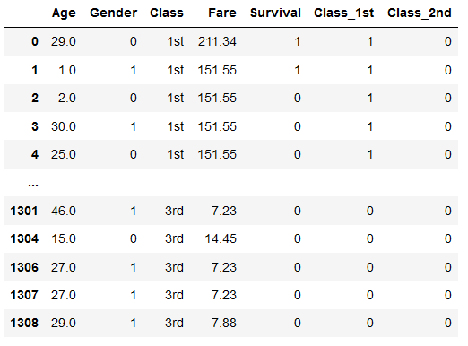
Titanic dataset – Dummy coded

Slide 16
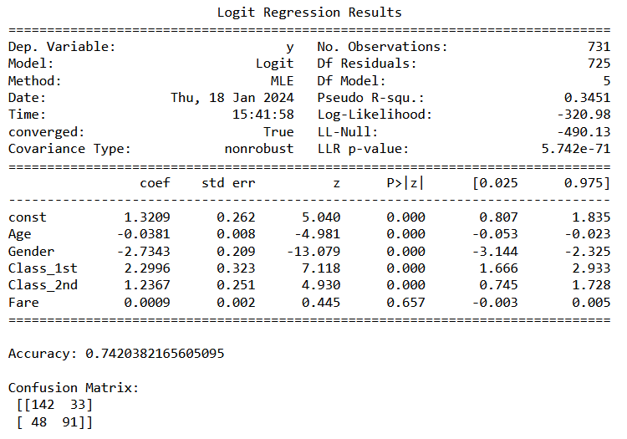
Logistic Regression Estimates & Metrics

Slide 17
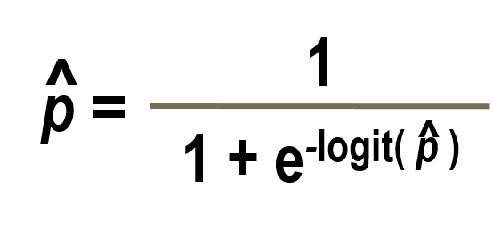
Logistic Regression Estimates
The above results give the estimated model as:
logit(p) = 1.3209 – 0.0381*(Age) – 2.7343*(Gender) + 2.2996*(Class_1st) + 1.2367*(Class_2nd) + 0.0009*(Fare)
Find the probability of a severe outage given
Age = 25; Gender = Female; Class = 2nd; Fare = 35
Substitute logit(p) value with the numbers above in the following formula to get probability of survival for the above passenger

Slide 18
Interpreting Logistic Regression Estimates
Since we converted the odds to log(odds) to estimate the coefficients, we need to convert the coefficient of each independent variable by raising it to the power of e to get odds ratio
In the above example, estimated odds ratio for variable Age =
e^{-0.0381}= 0.96
The odds ratio of 0.96 means that for every year increase in passenger’s age, the odds of survival decreases by 0.96 times (or decreases by 4%).
The estimated odds ratio for Gender = e^{-2.7343} = 0.065
The odds ratio of 0.065 means that the odds of survival for a Male passenger is 0.065 times lower compared to a Female passenger (or is 93.5% lower compared to a Female passenger)

Slide 19

Properties of the Odds Ratio
No Association
Group in denominator has higher
odds of the
event.
Group in numerator has higher
odds of the
event.
0 1

Slide 20
Logistic Regression Fit Measures
The logistic regression coefficients are estimated using maximum likelihood estimation (MLE).
Unlike the Least Squares Estimation used for linear regression models, the MLE begins with a tentative solution, revised it slightly to see if it can be improved, and repeats until the results have converged.
Logistic regression’s goodness of fit is measured as (-2*(log likelihood of the fitted model)).
Other measures are likelihood ratio, Cox and Snell R² and Nagelkerke R².
Wald Statistic, which is the ratio of the square of the regression coefficient to the square of the standard error of the coefficient, is used to assess the significance of each coefficient.

Slide 21
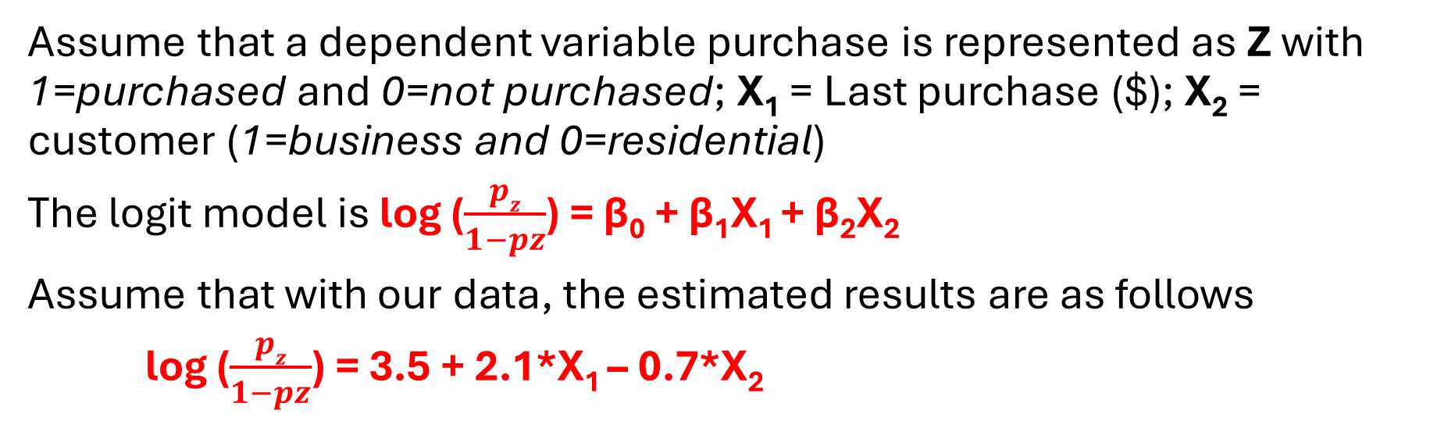
Logistic Regression – Problem
Assume that a dependent variable purchase is represented as Z with 1=purchased and 0=not purchased; X₁ = Last purchase ($); X₂ = customer (1=business and 0=residential)
The logit model is log ($\frac{pz}{1−pz}$) = β₀ + β₁X₁ + β₂X₂
Assume that with our data, the estimated results are as follows
log ($\frac{pz}{1−pz}$) = 3.5 + 2.1*X₁ – 0.7*X₂
From the above result, interpret the impacts of independent variable Last purchase and customer on the odds of purchase

Slide 22
Logistic Regression Estimation Tools
There are different software options to estimate logistic regression
The following are examples of add-ins available to solve logistic regression in Excel
Real Statistics Resource Pack: An Excel add-in available for free download from http://www.real-statistics.com
XLSTAT-Base: An Excel add-in available from https://www.xlstat.com/en/solutions/base with paid license
SAS, Stata, and SPSS Modeler are examples of non-Excel software that has logistic regression modeling capabilities
R is an open-source and popular statistical computing software that has logistic regression modeling capabilities

Slide 23
Sources
“Business Intelligence and Analytics” by Sharda et al., Pearson Education, 2015
“Advanced Business Analytics” Educator Training by SAS Inc.
http://www.real-statistics.com
http://docs.statwing.com/interpreting-residual-plots-to-improve-your-regression/
Miller, “Modeling Techniques in Predictive Analytics with R” FT Press

